Slide 1
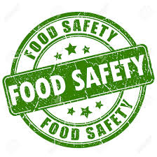
FOOD SAFETY

Slide 2
FOOD SAFETY
Food safety is important at all times: before, during and after cancer treatment!
WHY?
Your white blood cell counts may go down for short periods of time during your treatment. This can affect your body’s ability to fight infections.
When your white blood cells are very low, your immune system is not working at its best, so your body may be less able to fight infection from bacteria or other organisms that can be in food.

Slide 3
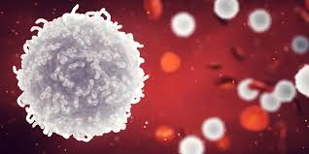
FOOD SAFETY
Your white blood cell count will gradually return to normal levels between and after your treatments.
Specific foods will not speed up the recovery of your white blood cell count.

Slide 4
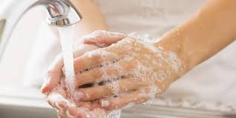
BASIC FOOD SAFETY RULES
WASH YOUR HANDS!
Using warm, soapy water, wash your hands for at least 20 seconds before preparing or eating food.
Wash your hands often through the day: after using the bathroom, touching pets, changing diapers, handling garbage, grocery shopping..

Slide 5
BASIC FOOD SAFETY RULES
BE CAREFUL PREPARING FOODS
Wash all fruits and vegetables under cold running water before peeling or cutting
Scrub fruits and vegetables with firm surfaces well (such as bananas, avocados, potatoes, oranges, melons)
Use separate cutting boards and utensils for raw meats and a separate one for fruits and vegetables
Thaw/defrost meat, fish or poultry in the refrigerator or microwave; not on the counter
Wash cutting boards, dishes, utensils and countertops with hot, soapy water after preparing food
Germs can grow on dishcloths so wash them daily in the hot cycle of the washing machine
Clean and sanitize countertops daily with a disinfectant cleaner

Slide 6
BASIC FOOD SAFETY RULES
BE CAREFUL COOKING FOODS
Cook meat until well done: USE A MEAT THERMOMETER
  Red meats: beef, pork, veal, lamb steaks, chops, roasts: to an internal temperature of 63℃ (145℉)
  Ground red meat: to an internal temperature of 71℃ (160℉)
  Poultry: chicken, turkey, duck (ground or pieces like breasts, legs, thighs): to an internal temperature of 74℃ (165℉)
  Cook fish and shellfish to an internal temperature of 63℃ (145℉)
  Cook eggs until the yolk and white are firm (71℃ (160℉).
Do not use any plates that held raw meat, fish, poultry or eggs without washing it first. Make sure to use hot, soapy water on these dishes before reusing.

Slide 7
BASIC FOOD SAFETY RULES
SHOP SMART
Check expiration dates on dairy products, meats, eggs and prepared and packaged items.
Purchase only pasteurized milk, juices and honey.
Avoid items from bulk food containers, bins and deli foods that can be handled by many people.
Don’t buy canned, jarred or boxed foods with dents, swelling, broken seal.
Choose fresh fruits and vegetables that are not spoiled or bruised (they can collect bacteria faster).
Avoid food sample offers at grocery stores or food markets
Avoid buffets, potlucks, salad bars, sidewalk vendors…

Slide 8
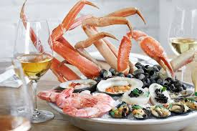
BASIC FOOD SAFETY RULES
FOODS TO AVOID
Raw or undercooked eggs (like in Caesar salad dressing, raw cookie dough, hollandaise sauce)
Raw or undercooked meat, fish, poultry, tofu and seafood
NON-pasteurized milk, cheese, yogurt
Soft cheese or blue veined cheese: Brie, Camembert, Roquefort, Stilton, Gorgonzola or Blue)

Slide 9
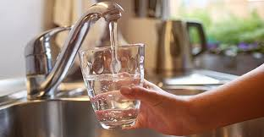
BASIC FOOD SAFETY RULES
FOODS TO AVOID
Unwashed fruits or vegetables
Raw or uncooked sprouts (alfalfa or bean sprouts)
Cold or uncooked deli meats (cold cuts) and hotdogs
DRINKING WATER SAFELY
Tap water and bottled water is safe to drink. You may wish to boil water at a rolling boil for 5 minutes before drinking if you are concerned about your water supply.

